Slide 1
Saliency map
2021_BEP

Slide 2
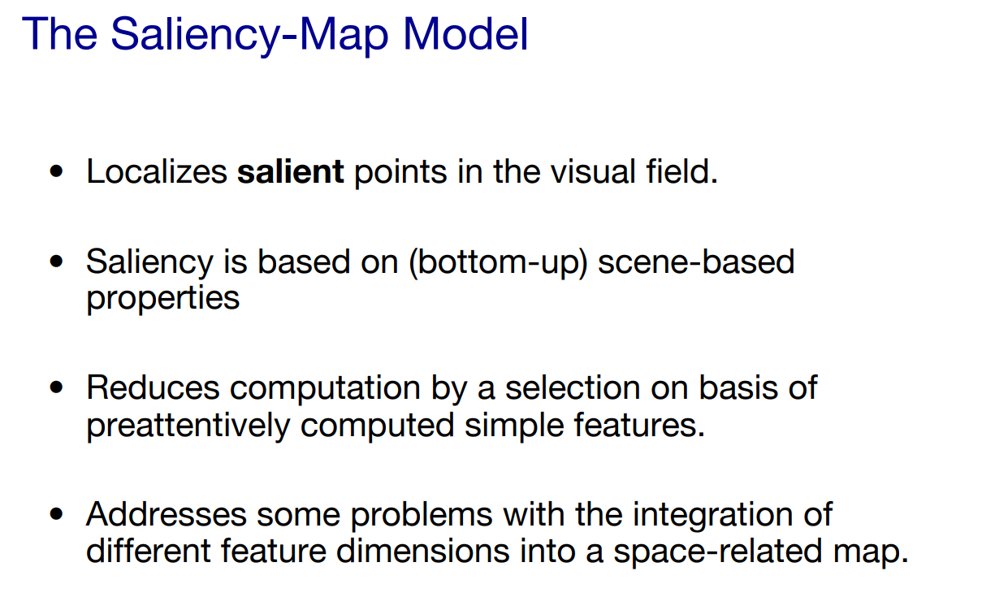
Notes:
Quality is considered to be the correspondence between a machine's output and that of a human: "the closer a machine translation is to a professional human translation, the better it is - this is the central idea behind BLEU
BLEU was one of the first metrics to claim a high correlation with human judgements of quality, and remains one of the most popular automated and inexpensive metrics.
2

Slide 3
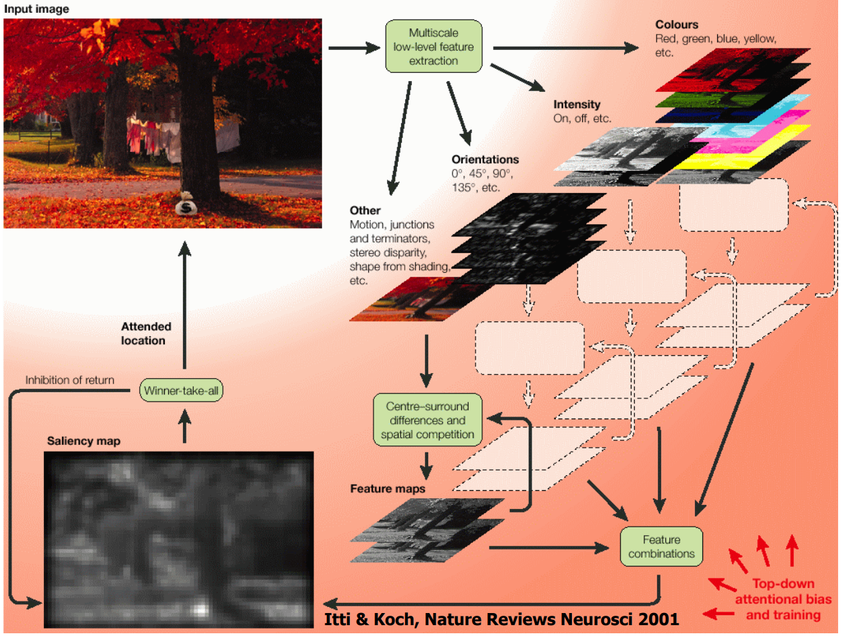
Notes:
Quality is considered to be the correspondence between a machine's output and that of a human: "the closer a machine translation is to a professional human translation, the better it is - this is the central idea behind BLEU
BLEU was one of the first metrics to claim a high correlation with human judgements of quality, and remains one of the most popular automated and inexpensive metrics.
3

Slide 4
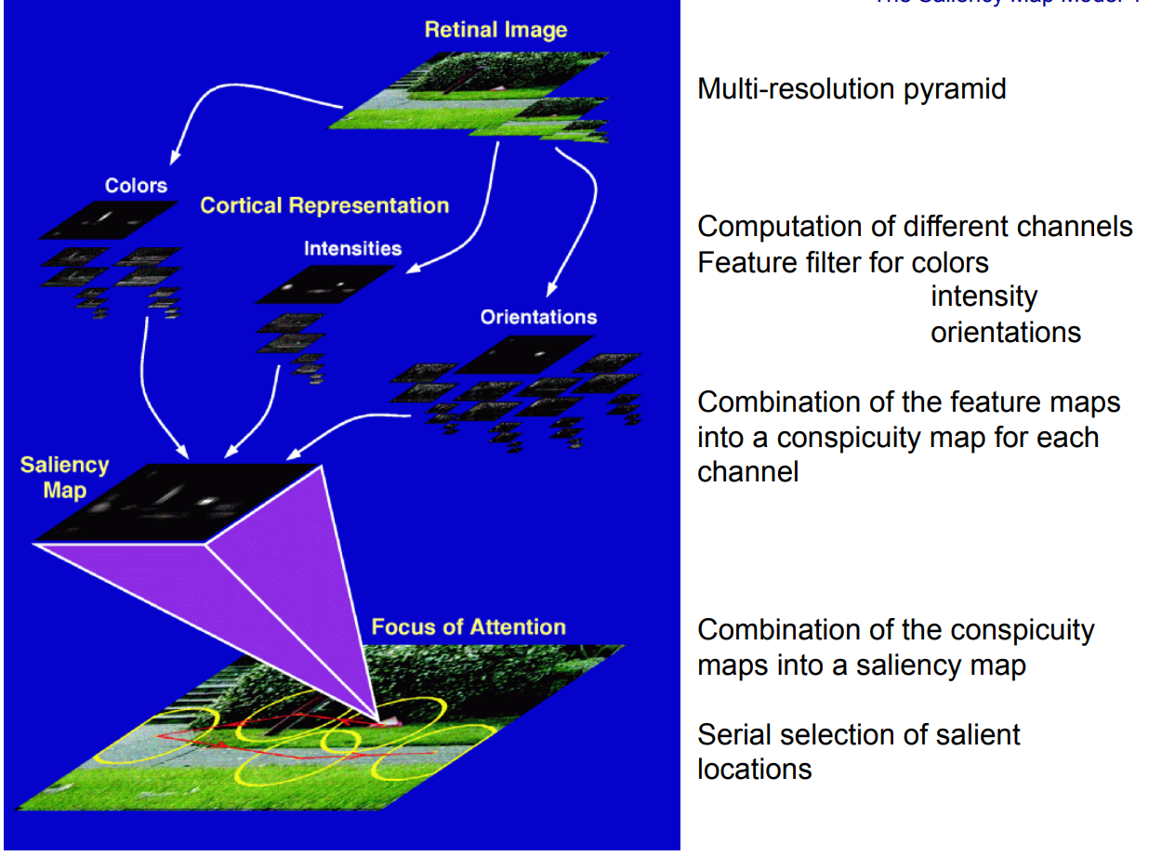
Notes:
Quality is considered to be the correspondence between a machine's output and that of a human: "the closer a machine translation is to a professional human translation, the better it is - this is the central idea behind BLEU
BLEU was one of the first metrics to claim a high correlation with human judgements of quality, and remains one of the most popular automated and inexpensive metrics.
4

Slide 5
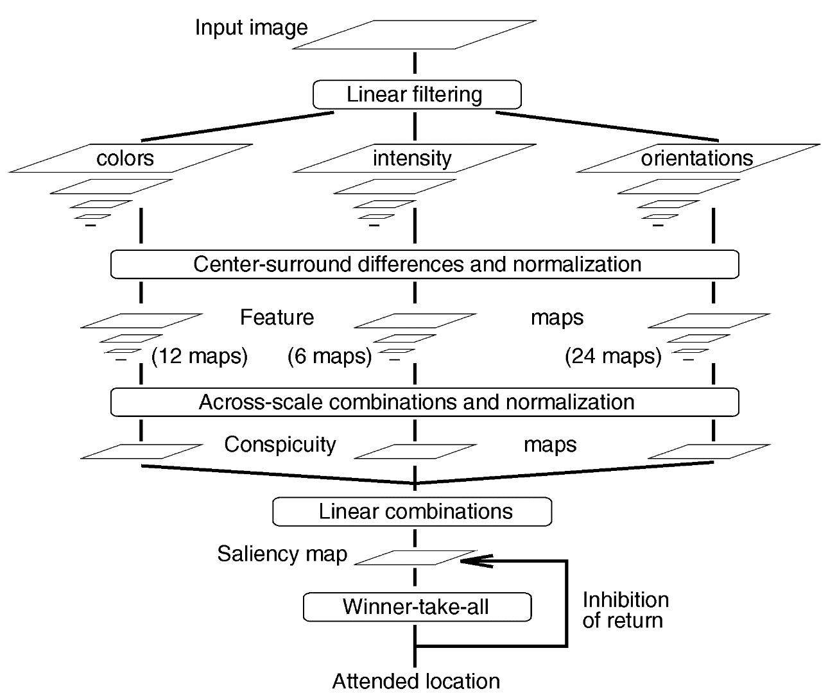
Notes:
Quality is considered to be the correspondence between a machine's output and that of a human: "the closer a machine translation is to a professional human translation, the better it is - this is the central idea behind BLEU
BLEU was one of the first metrics to claim a high correlation with human judgements of quality, and remains one of the most popular automated and inexpensive metrics.
5

Slide 6
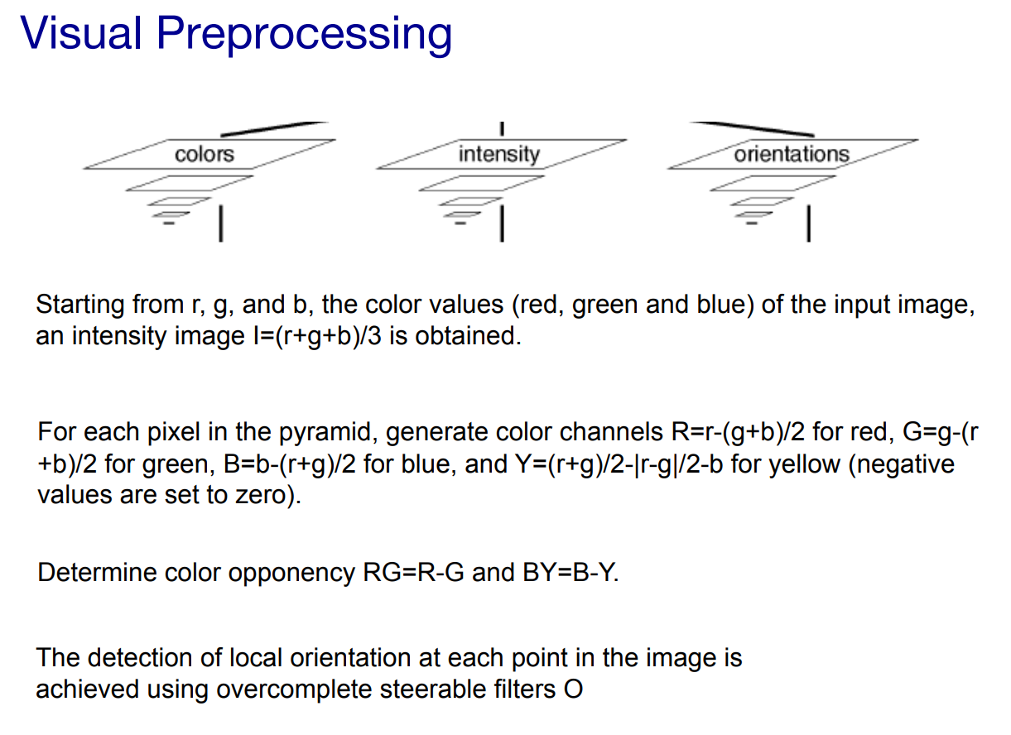
Notes:
Quality is considered to be the correspondence between a machine's output and that of a human: "the closer a machine translation is to a professional human translation, the better it is - this is the central idea behind BLEU
BLEU was one of the first metrics to claim a high correlation with human judgements of quality, and remains one of the most popular automated and inexpensive metrics.
6

Slide 7
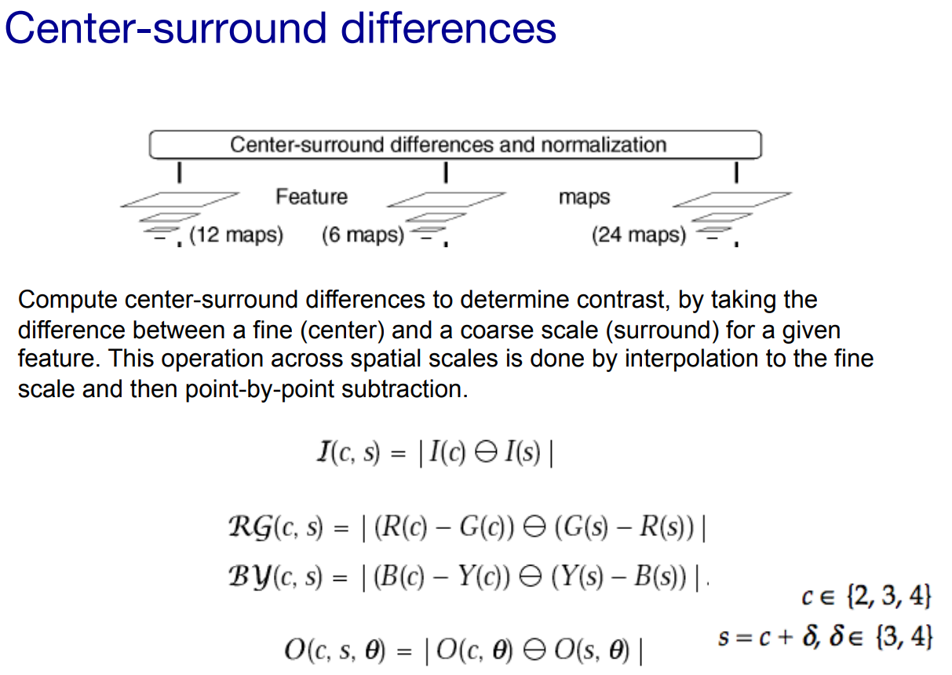
Notes:
Quality is considered to be the correspondence between a machine's output and that of a human: "the closer a machine translation is to a professional human translation, the better it is - this is the central idea behind BLEU
BLEU was one of the first metrics to claim a high correlation with human judgements of quality, and remains one of the most popular automated and inexpensive metrics.
7

Slide 8
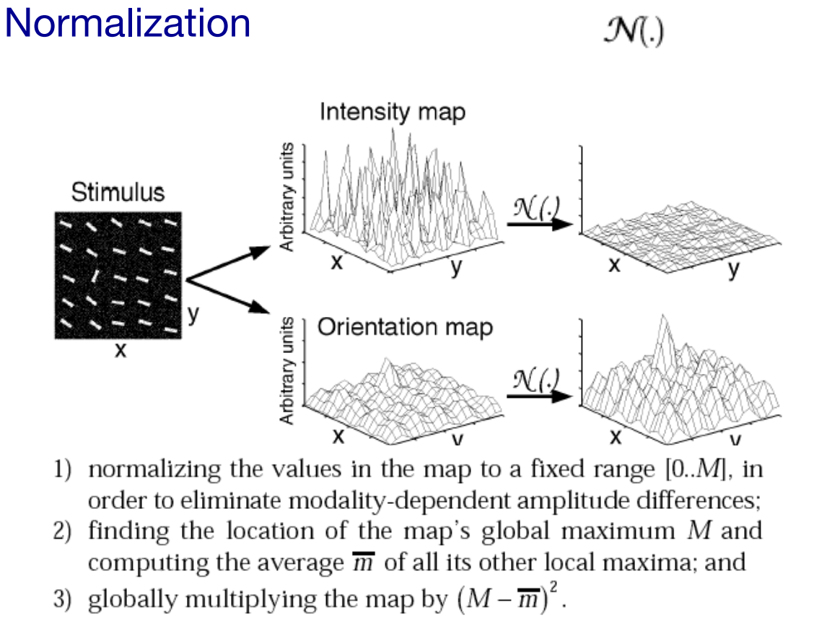
Notes:
Quality is considered to be the correspondence between a machine's output and that of a human: "the closer a machine translation is to a professional human translation, the better it is - this is the central idea behind BLEU
BLEU was one of the first metrics to claim a high correlation with human judgements of quality, and remains one of the most popular automated and inexpensive metrics.
8

Slide 9
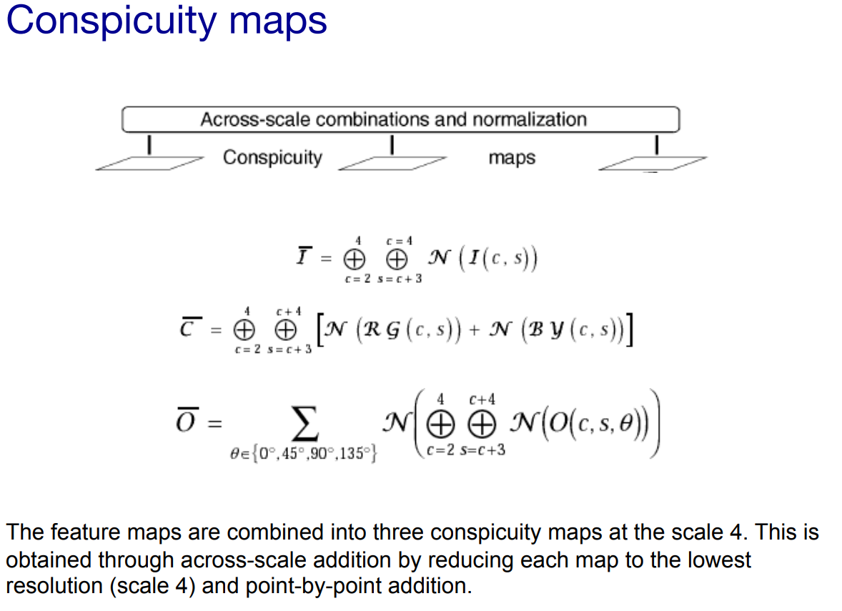
Notes:
Quality is considered to be the correspondence between a machine's output and that of a human: "the closer a machine translation is to a professional human translation, the better it is - this is the central idea behind BLEU
BLEU was one of the first metrics to claim a high correlation with human judgements of quality, and remains one of the most popular automated and inexpensive metrics.
9

Slide 10
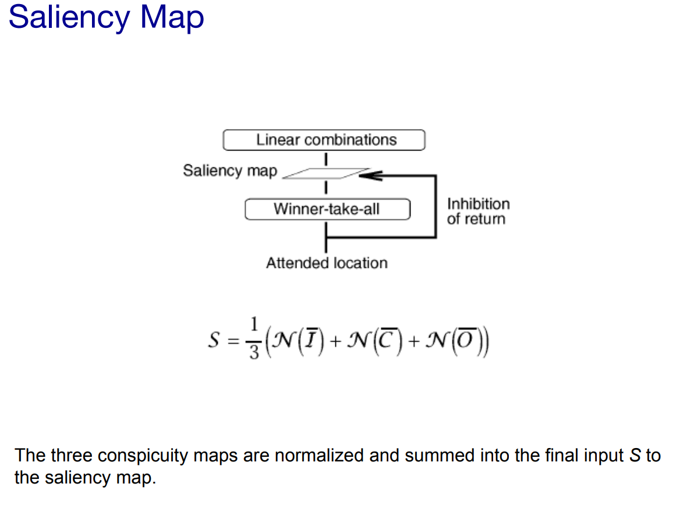
Notes:
Quality is considered to be the correspondence between a machine's output and that of a human: "the closer a machine translation is to a professional human translation, the better it is - this is the central idea behind BLEU
BLEU was one of the first metrics to claim a high correlation with human judgements of quality, and remains one of the most popular automated and inexpensive metrics.
10

Slide 11
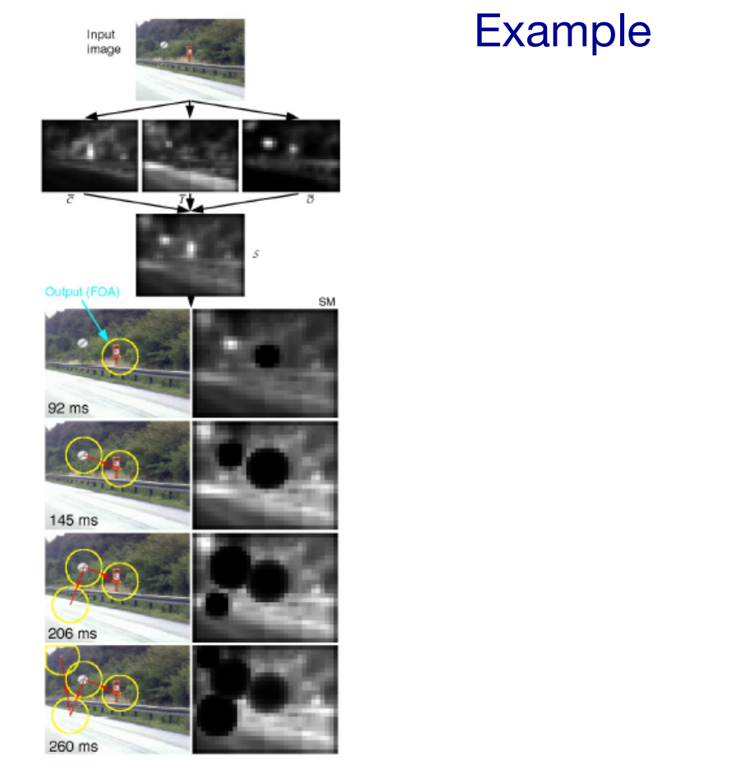
Notes:
Quality is considered to be the correspondence between a machine's output and that of a human: "the closer a machine translation is to a professional human translation, the better it is - this is the central idea behind BLEU
BLEU was one of the first metrics to claim a high correlation with human judgements of quality, and remains one of the most popular automated and inexpensive metrics.
11

Slide 12
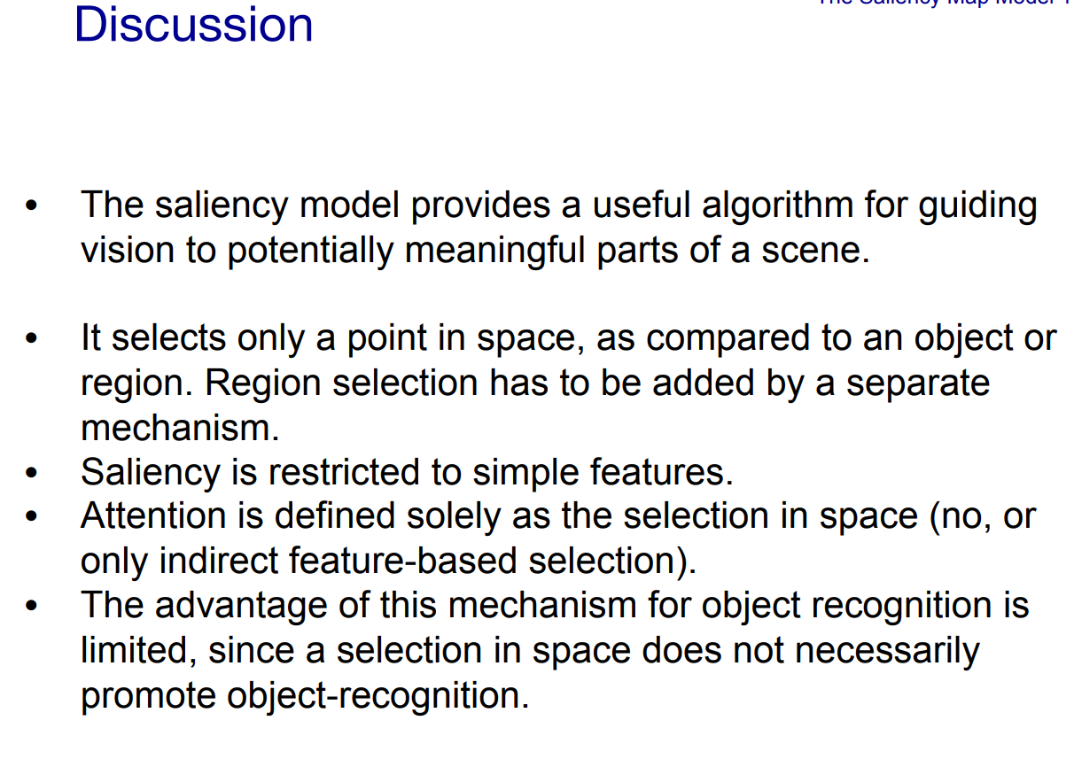
Notes:
Quality is considered to be the correspondence between a machine's output and that of a human: "the closer a machine translation is to a professional human translation, the better it is - this is the central idea behind BLEU
BLEU was one of the first metrics to claim a high correlation with human judgements of quality, and remains one of the most popular automated and inexpensive metrics.
12

Slide 13
Assignment
Pick a random image and generate its Salency map. https://www.pyimagesearch.com/2018/07/16/opencv-saliency-detection/
Notes:
Quality is considered to be the correspondence between a machine's output and that of a human: "the closer a machine translation is to a professional human translation, the better it is - this is the central idea behind BLEU
BLEU was one of the first metrics to claim a high correlation with human judgements of quality, and remains one of the most popular automated and inexpensive metrics.
13

Slide 14
Thank You
Notes:
Quality is considered to be the correspondence between a machine's output and that of a human: "the closer a machine translation is to a professional human translation, the better it is - this is the central idea behind BLEU
BLEU was one of the first metrics to claim a high correlation with human judgements of quality, and remains one of the most popular automated and inexpensive metrics.
14

